Slide 1
Session 12 - Emerging Compromise
MIS 6311-501 Cyber Security Fundamentals
Chris Davis

Slide 2
Housekeeping
Any Questions? Please do not hesitate to email.
Class Website: https://elearning.utdallas.edu
UTD Email: cmd140430@utdallas.edu
Google Voice: 214-771-8122 (Emergencies)
LinkedIn: www.LinkedIn.com/in/ChristopherDavis
Blog: www.cloudauditcontrols.com
Dropbox: https://goo.gl/7WTLAF
Class: Monday 7:00pm-9:45pm

Slide 3
Academic Sessions

Slide 4
Comparison of Our Class to CISSP Domains
Shon Harris Book – Chapters
Current CISSP Domains
2
Information Security Governance and Risk Management
8
Business Continuity and Disaster Recovery Planning
Security and Risk Management
9
Legal, Regulations, Investigations and Compliance
7
Cryptography
Security Engineering
4
Security Architecture and Design
Security Assessment and Testing
5
Physical (Environmental) Security
Asset Security
6
Telecommunications and Network Security
Communications and Network Security
3
Access Control
Identity and Access Management
11
Operations Security
Security Operations
10
Software Development Security
Software Development Security

Slide 5
PROJECT PRESENTATIONS

Slide 6
Tales from the Crypt.
Practical Applications & Lessons Learned.

Slide 7
Welcome to breathtaking Tokyo Water Park where you can wash away the pressure and stress of the overcrowded city and relax with your friends in the soothing enjoyment of sun, fun and splashing
Tokyo Water Park

Slide 8


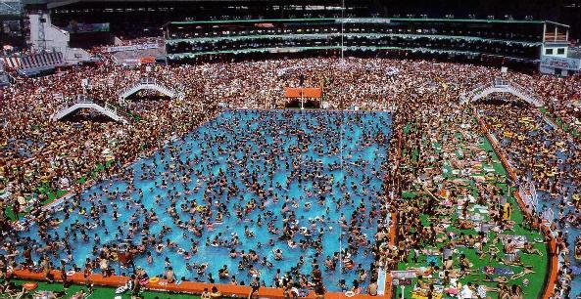


Slide 9
Data Breach Sources
Open Security Foundation: datalossdb and osvdb (http://www.opensecurityfoundation.org/ )
Computer Security Institute (CSI): http://gocsi.com/
Office of Inadequate Security: http://www.databreaches.net/
Identity Theft Resource Center: http://www.idtheftcenter.org/
ISACA: www.isaca.org
ISSA: www.issa.org
Mitre Corporation: www.mitre.org
OWASP: http://owasp.com/index.php/Main_Page
Privacy Rights Clearing House: http://www.privacyrights.org/
SANS: www.sans.org
The Ponemon Institute: www.ponemon.org
www.databreachcalculator.com.
List Compiled by: Patrick Florer

Slide 10
Data Trend Analysis Sources
Google trends: http://www.google.com/trends
Twitter Trends: www.trendistic.com
Amazon: http://www.metricjunkie.com/
More on Risk Analysis:
Security Metrics mailing list: www.securitymetrics.org
Society of Information Risk Analysts (SIRA): http://societyinforisk.org/
List Compiled by: Patrick Florer

Slide 11
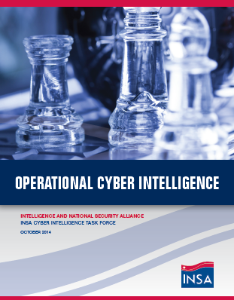
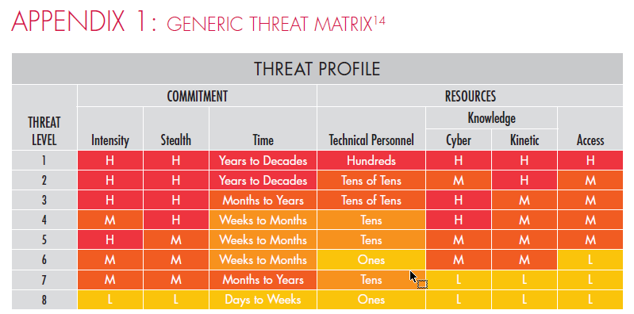
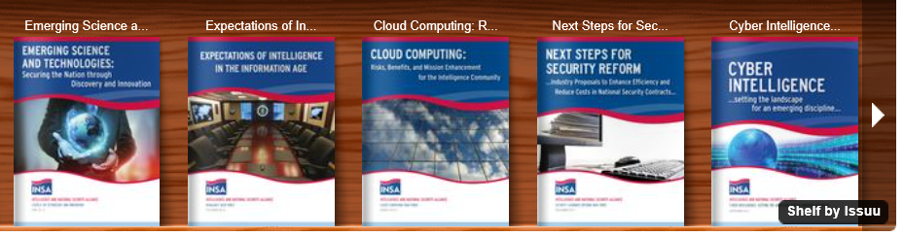
http://www.insaonline.org/i/d/a/Index.aspx

Slide 12
Let’s Get Started.

Slide 13
Emerging Compromise
Brian E. Brzezicki

Slide 14
Soft Skills
Source: Lenny Zeltser (Savvis Security Consulting Team Lead)
http://zeltser.com/cheat-sheets/human-communications-cheat-sheet.html
His website has an MS Word version that can be edited.

Slide 15
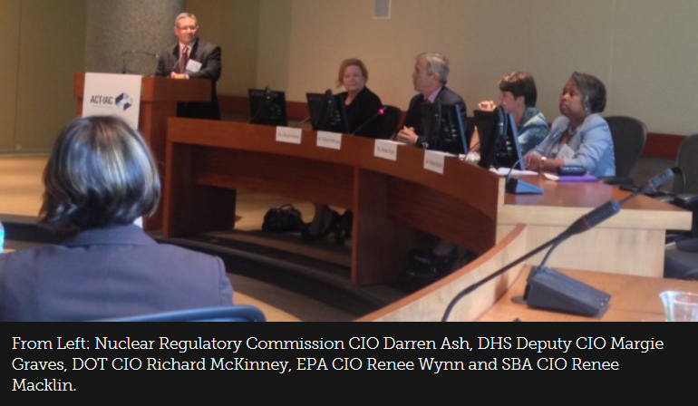
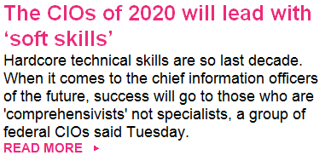

Slide 16
What if They Just Don't Get It?
They may want to agree, but emotions won't let them. Help them back out without losing face.
Don't assume they don't understand your reasoning; explaining again in the same way often doesn't help.
Empathy is the key. What is your listener's perspective? What's important to him or her?
Acknowledge your differences in perspectives.
Phrase your argument using your listener's terminology, objectives, and world view.
Maybe you're not yelling loudly enough. (Kidding!)
Take a time out. Switch the venue or medium.
Involve an impartial, respected person as a mediator.
Watch out for jargon. If it obfuscates the issue, look for a way to get it rephrased.
Track interaction approaches that work with the person; stick to the method that succeeded earlier.
Maybe you're wrong. It happens to the best of us.

Slide 17
Technically Speaking.
Persuading a More Technical Person
Research technical aspects of the issue beforehand. What objections or new data may arise?
Get solid data to support your argument. Be ready to drill into details.
Practice in front of a friendly more technical person.
Persuading a Less Technical Person
Don't make the other party feel dumb due to the lack of technical insight. Sounding superior backfires.
State your conclusion first, before discussing the details of how you arrived at it.
Research non-technical aspects of the issue beforehand. What objections or new data may arise?
Practice in front of a friendly less technical person.

Slide 18
Tips for Better Email Messages
If you haven't persuaded after several back and forth emails, pick up the phone, or speak in-person.
If your message is longer than 2 paragraphs, shorten it or use another medium.
If your email is being ignored, send a follow-up. Don't take it personally—people get too much email.
Note time of day/day of the week when the recipient responds most often. Send your message then.
Lead with the strongest statement to grab attention.

Slide 19
Tips for Better Email Messages
Assume only your first 2 sentences will be read.
Use the Subject line to get your main point across.
Use email to prepare the person for an in-person meeting or a phone conversation.
Don't respond in the heat of the moment. Let your emotions cool off before hitting the Send button.
Don't forget about non-email mediums: phone, postal mail, Twitter, Facebook, billboard, tattoo, etc.

Slide 20
In-Person Conversations
Dress appropriately for the venue, topic, expectations, and social norms.
Consider where to speak: your workplace, his or her workplace, water cooler, lunchroom, etc.
Find the best timing: some are grumpy in the mornings, sleepy after lunch, in a hurry at 5pm, etc.
Come prepared. Impromptu talks on important topics have been known to lead to trouble.
Harness the power of sharing a tasty treat.

Slide 21
In-Person Conversations
When in doubt, use a breath freshener.
If you or the other party are in a foul mood, consider putting the conversation on hold and resuming later.
Mimic the other party's general posture and gestures, but not exactly movement for movement.
Be mindful of cultural differences in gestures and the distance between speaking parties.
Smile. Breathe. Don't avoid eye contact.
Conclude by agreeing on the next steps and timeline.
If sending a thank-you note, send it ASAP.

Slide 22
Presenting to Managers and Executives
Be brief. (E.g., consider "the elevator pitch.")
Make your message business-relevant.
If showing slides, use fewer bullet points. Consider skipping the slides altogether.
In preparation, ask yourself and answer, "So what?" for the facts and conclusions you will discuss.
Find an "executive sponsor" who will offer feedback in before and support you during the presentation.
Use the tools, terminology, and conventions that your audience employs (e.g., the SWOT matrix).

Slide 23
The Elevator Pitch
Examples: http://pitches.techcrunch.com
Consider these: SmugMug, Ugobe, Framr
They are brief. The listener has a limited attention span.
They are specific. The issues they bring up are easy to understand and visualize.
They differentiate. The speaker clarifies what his issue different from the rest.
They empathize with the listener. The listener needs to know why he should care.
They have a clear ending point. The speaker clarifies at the end what he wants the listener to do.

Slide 24
Security Elevator Pitch – Example 1
"Our extranet website is missing dozens of critical security updates. The site could crash or become infected at any minute, and it may take us weeks to recover. This will prevent us from communicating with our supply chain partners, and will lead to thousands in losses. The challenge is that the app running on the server was written years ago by people who left the company, so everyone is afraid to touch the server. Yet, if we do nothing, we're sitting on a ticking time bomb. I need your help to get the right people together so we can make a decision. Could I invite you to a 30-minute meeting I'm organizing for tomorrow?"

Slide 25
Security Elevator Pitch – Example 2
"Have you noticed that every vendor who visits us plugs into our LAN as soon as they unpack their laptop? If their system has a virus, the infection will likely spread to our internal systems. This is a significant threat we have not considered, as our patching practices rely heavily on the effectiveness of our network perimeter. As a result, our internal servers could get compromised, severely disrupting operations. I evaluated a few products that would let us control who can plug into the LAN. Could we speak next Monday about this issue--I think I have a solution you might like, but I need your feedback before continuing with the project."

Slide 26
At a Social Networking Reception
Come early—fewer people and attendees are fresh.
Don't stay by your friends' side. Meet new people.
It's OK to come up to groups of strangers and join a conversation. Receptions are public conversations.
Welcome newcomers into your conversations.

Slide 27
At a Social Networking Reception
Prepare chit-chat topics by reading news, books
Hold an appropriate prop (e.g., wine glass) in one hand, but have one hand free to shake hands.
Use people's names when speaking with them.
Be enthusiastic. Try to look friendly, approachable.

Slide 28
Improving Communication Skills
Improvisational or stand-up comedy classes help.
Consider joining a local Toastmasters club.
Attend writing workshops (creative, resume, etc.).
Practice on friends and in low-risk environments.
50 Scientifically Proven Ways to Be Persuasive
Made to Stick: Why Some Ideas Survive and Others Die
How to Be Heard in IT Security and Business

Slide 29
Notes on Good Resources

Slide 30
Excellent Cheat Sheets
http://zeltser.com/cheat-sheets
http://packetlife.net/library/cheat-sheets
http://whatis.techtarget.com/definition/0,,sid9_gci826135,00.html

Slide 31
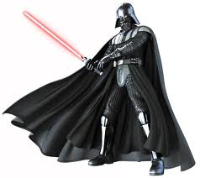
Exploring THE DARK SIDE

Slide 32
How would a professional criminal use the information we studied in this course against you?

Slide 33
What we studied

Slide 34
Summary of an Information Security Program
Management support
Determine scope
Inventory
Risk assessment
Identify objectives
Identity controls
Policies
Allocate resources
Train
Implement
Document
Accreditation
Monitor
Records
What could *possibly* go wrong?!
What outward indications would you see?
Job postings?

Slide 35
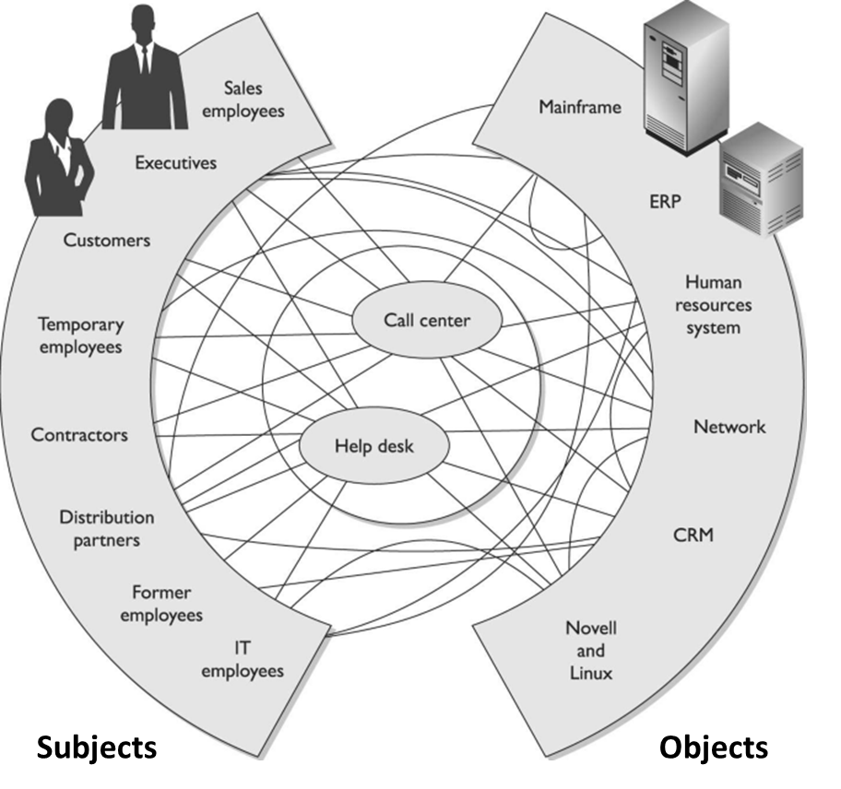

Identity Management
Where can I get them?
What about passwords?
Dictionaries?
Authentication issues?

Slide 36
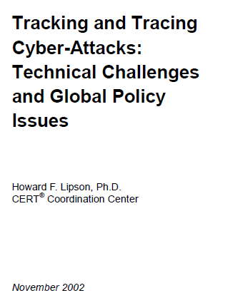
5 Shortfalls in the Current Internet Environment ...........................................13
5.1 The Internet was never designed for tracking and tracing user
behavior ..................................................................................................13
5.2 The Internet was not designed to resist highly untrustworthy users .........13
5.3 A packet’s source address is untrustworthy, which severely hinders
tracking....................................................................................................14
5.4 The current threat environment far exceeds the Internet’s design
parameters ..............................................................................................15
5.5 The expertise of the average system administrator continues to
decline.....................................................................................................16
5.6 Attacks often cross multiple administrative, jurisdictional, and national
boundaries ..............................................................................................16
5.7 High-speed traffic hinders tracking ..........................................................17
5.8 Tunnels impede tracking..........................................................................18
5.9 Hackers destroy logs and other audit data...............................................18
5.10 Anonymizers protect privacy by impeding tracking ..................................18
5.11 The ability to link specific users to specific IP addresses is being lost......18
5.12 Purely defensive approaches will fail, so deterrence through tracking
and tracing is crucial................................................................................20

Slide 37
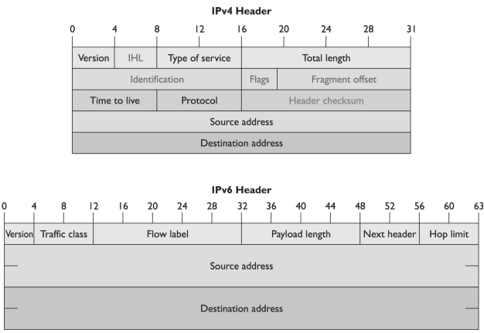
IPV4 vs. IPV6

Slide 38
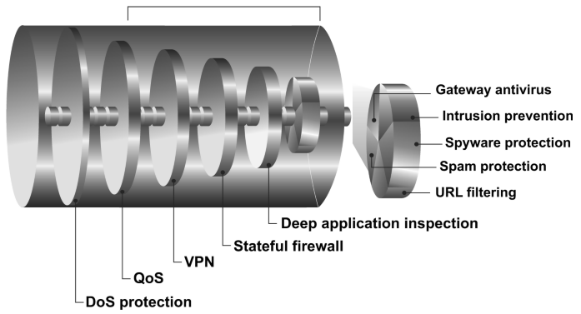
Understand what your vendor can provide
Developed that provide all (or many) of these functionalities in a single network appliance.
The goals of UTM are simplicity, streamlined installation and maintenance, centralized control, and the ability to understand a network’s security from a holistic point of view.
The list includes, but is not limited to, firewalls, antimalware , antispam, IDS/ IPS, content filtering, data leak prevention, VPN capabilities, and continuous monitoring and reporting.

Slide 39
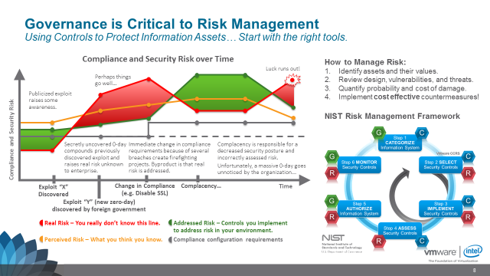

Slide 40
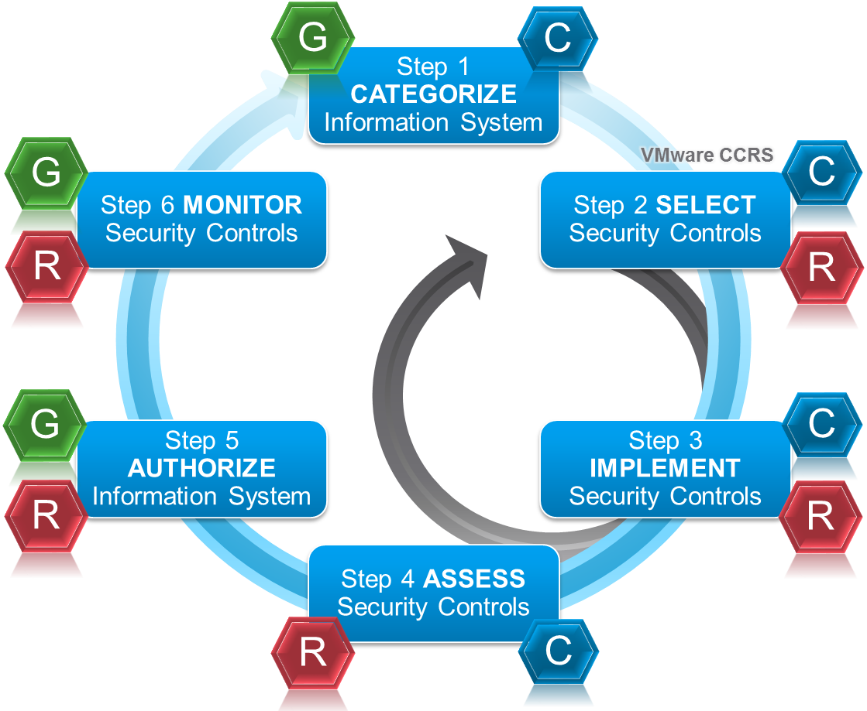
Governance is Critical to Risk Management Using Controls to Protect Information Assets… Start with the right tools.
Compliance and Security Risk over Time
How to Manage Risk:
Identify assets and their values.
Review design, vulnerabilities, and threats.
Quantify probability and cost of damage.
Implement cost effective countermeasures!
NIST Risk Management Framework
Luck runs out!
Perhaps things go well…
Publicized exploit raises some awareness.
Compliance and Security Risk
Secretly uncovered 0-day compounds previously discovered exploit and raises real risk unknown to enterprise.
Immediate change in compliance requirements because of several breaches create firefighting projects. Byproduct is that real risk is addressed.
Complacency is responsible for a decreased security posture and incorrectly assessed risk.
Unfortunately, a massive 0-day goes unnoticed by the organization...
Exploit “X” Discovered
Change in Compliance (e.g. Disable SSL)
Complacency…
Time
Exploit “Y” (new zero-day) discovered by foreign government
Real Risk – You really don’t know this line.
Addressed Risk – Controls you implement to address risk in your environment.
Perceived Risk – What you think you know.
Compliance configuration requirements
Notes:
With that backdrop, let’s discuss risk management as many face it today

Slide 41
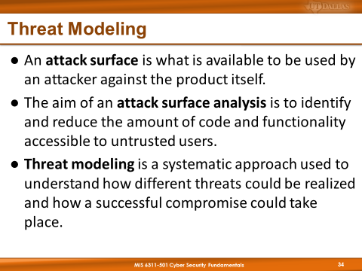
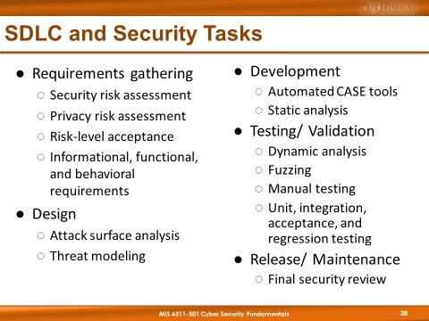

Slide 42
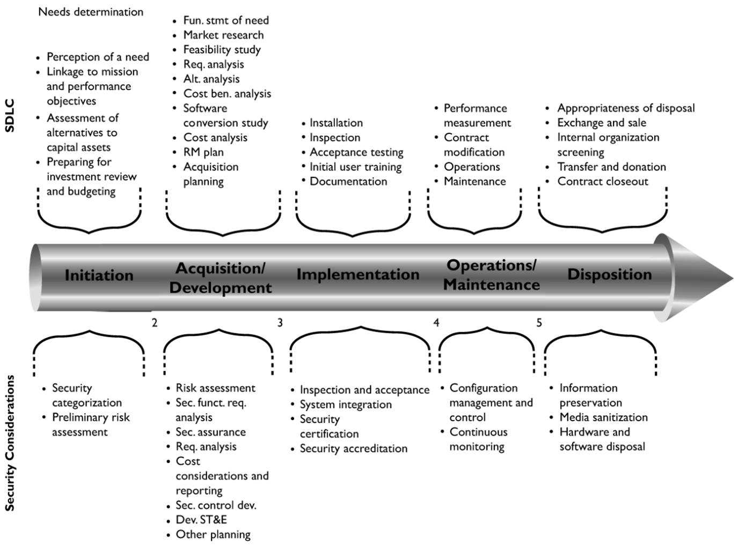

Slide 43
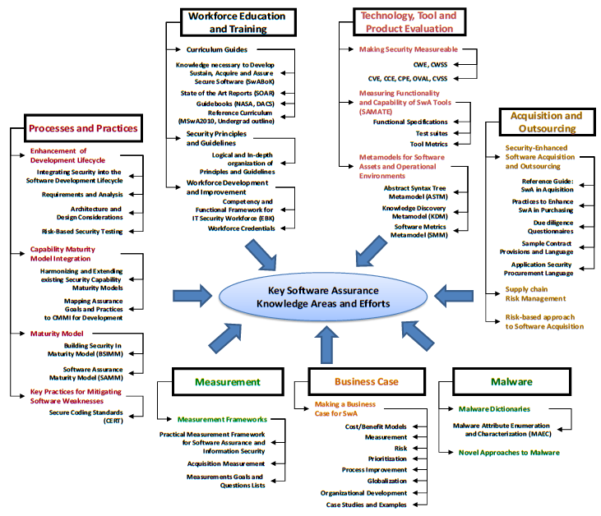
https://buildsecurityin.us-cert.gov/sites/default/files/SwAWTPG-08-29-11v2.24.pdf

Slide 44
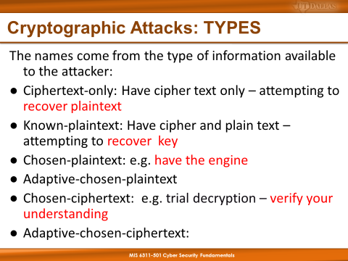
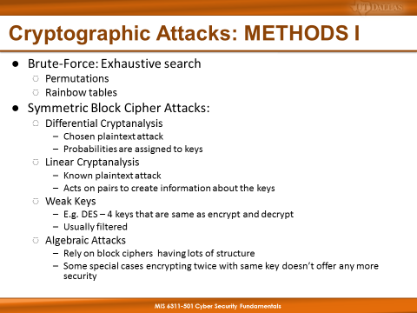
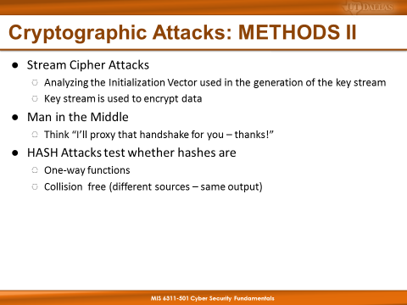

Slide 45
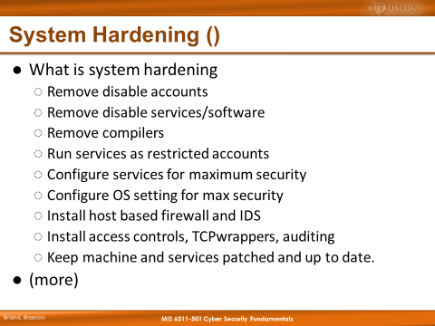
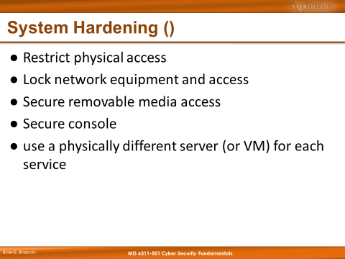
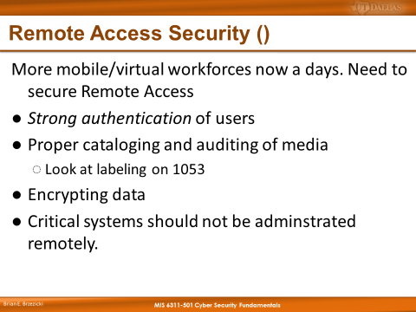
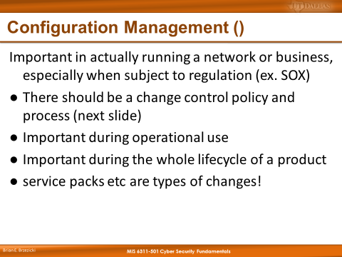
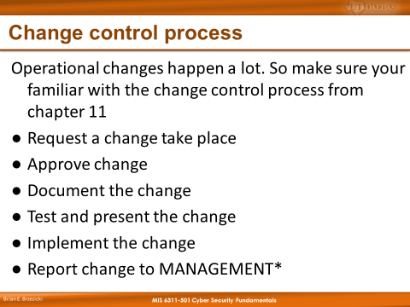
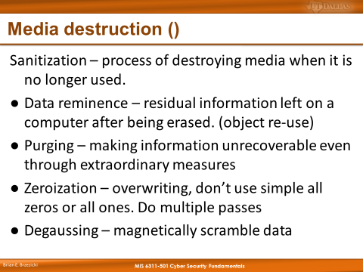
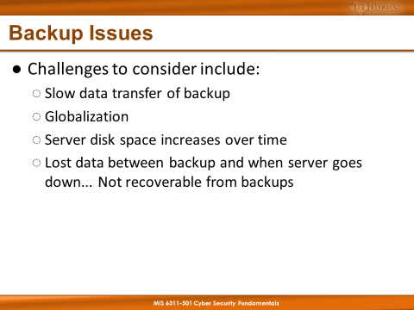

Slide 46
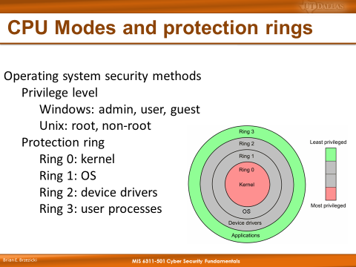
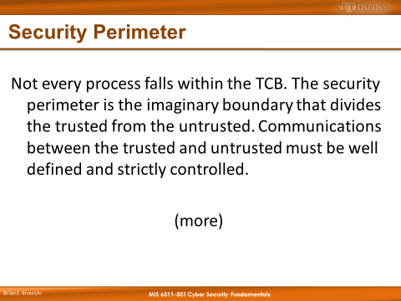
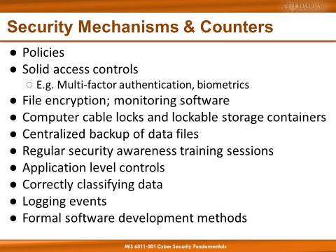
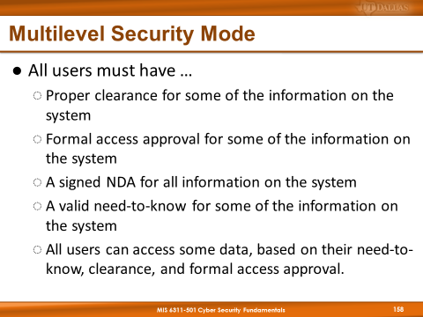

Slide 47
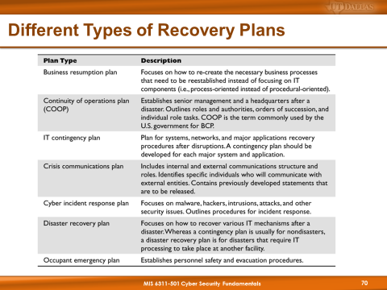
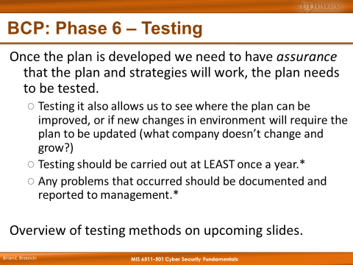

Slide 48
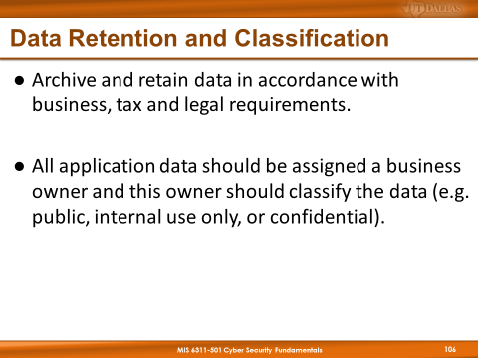
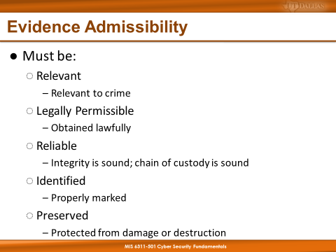
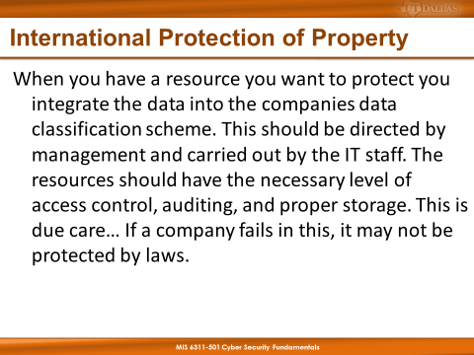

Slide 49
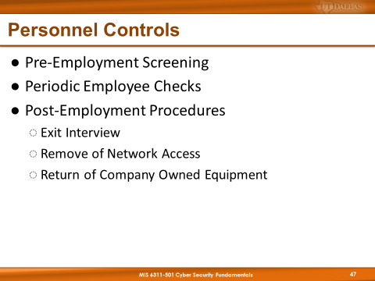
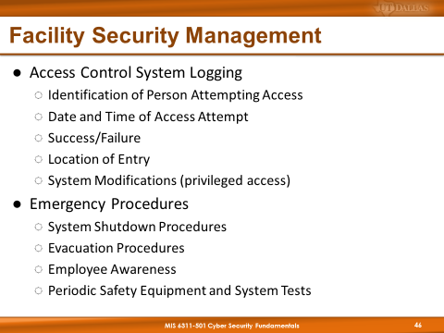
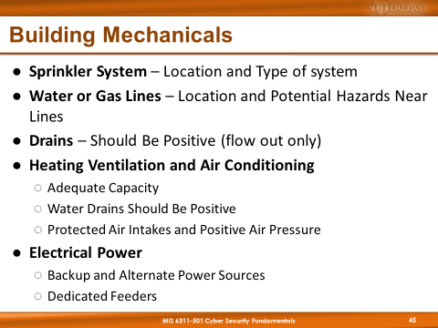

Slide 51
Tales from the Crypt.
Practical Applications & Lessons Learned

Slide 52
Data Breach Sources
Open Security Foundation: datalossdb and osvdb (http://www.opensecurityfoundation.org/ )
Computer Security Institute (CSI): http://gocsi.com/
Office of Inadequate Security: http://www.databreaches.net/
Identity Theft Resource Center: http://www.idtheftcenter.org/
ISACA: www.isaca.org
ISSA: www.issa.org
Mitre Corporation: www.mitre.org
OWASP: http://owasp.com/index.php/Main_Page
Privacy Rights Clearing House: http://www.privacyrights.org/
SANS: www.sans.org
The Ponemon Institute: www.ponemon.org
www.databreachcalculator.com.
List Compiled by: Patrick Florer

Slide 53
Data Trend Analysis Sources
Google trends: http://www.google.com/trends
Twitter Trends: www.trendistic.com
Amazon: http://www.metricjunkie.com/
More on Risk Analysis:
Security Metrics mailing list: www.securitymetrics.org
Society of Information Risk Analysts (SIRA): http://societyinforisk.org/
List Compiled by: Patrick Florer

Slide 54
Data theft: Top 5 most expensive data breaches
Source:http://www.csmonitor.com/Business/2011/0504/Data-theft-Top-5-most-expensive-data-breaches/5.-US-Veterans-Affairs-25-30-million
Remember These?
It hasn’t improved.
Data theft is off to a troubling start this year, with two massive breaches occurring in March and April. Hackers' success in grabbing millions of records at Epsilon and Sony are just the latest example of increasingly sophisticated attempts to steal sensitive personal information.
Here's a list of the five most expensive data theft cases in the United States.

Slide 55
US Veterans Affairs - $25-$30 million
The names, birth dates, and Social Security numbers of 17.5 million military veterans and personnel were stolen in 2006 from a laptop that a Department of Veterans Affairs employee had taken home. The costs to the VA included money for running call centers, sending out mailings, and and paying for a year of a credit-monitoring service for victims.
The Ponemon Institute, a research organization in Traverse City, Mich., estimates the breach cost at least $25 million.

Slide 56
Heartland Payment Systems - $140 million
Heartland Payment Systems, a payment processor based in Princeton, N.J., was the victim of a major cyber attack in 2008.
Criminals installed spying software on the company’s computer network and stole the numbers of as many as 100 million credit and debit cards.
Albert Gonzales, a hacker from Miami, was accused of playing a critical role in the Heartland hack, as well as other massive data breaches of companies including retailer TJX, 7-Eleven, Inc., and the grocery chain Hannaford Bros.
Gonzales was sentenced to 20 years in federal prison.
The company paid about $140 million in fines and settlements.

Slide 57
TJX – $256 million or more
The Framingham, Mass., retailer that owns national chains including TJ Maxx and Marshalls, estimated that a 2007 data breach would cost the company about $25 million.
But in the end, the total cost was at least 10 times as high.
Cyber criminals took more than 45 million credit and debit card numbers, some of which were used later to buy millions of dollars in electronics from Wal-Mart and elsewhere.
Mr. Gonzales, who played a major role in the Heartland hack, was linked to this cyber attack as well.

Slide 58
(tie) Epsilon - to be determined
In March 2011, hackers stole millions of names and e-mail addresses from the Dallas-based marketing firm.
Epsilon handles e-mail lists for major retailers and banks like Best Buy, JPMorgan, TiVo, Walgreen, and Kroger.
A study by CyberFactors, a cyber risk analytics company, estimates that the breach could cost between $225 million and $4 billion, depending on what happens with the stolen data, Business Wire reports.
Mr. Ponemon offers a lower estimate: at least $100 million, with most of the lost costs going toward losing customers due to a damaged reputation.
Notes:
Ponemon says that because the stolen data was e-mail information, the costs won't be as high as if financial information had been stolen.

Slide 59
(tie) Sony - to be determined
The Sony data breach, which exposed information from more than 100 million user accounts in April, could prove to be the mostly costly data breach of all time.
Hackers obtained personal information, including credit, debit, and bank account numbers in some instances, of PlayStation Network users and Sony Online Entertainment users.
After discovering there had been a breach, Sony shut down both networks temporarily.
Ponemon estimates that the breach could cost Sony and credit card issuers up to a total of $2 billion.

Slide 60
Penetration Testing

Slide 61
Penetration Testing Methodologies
Open Source Security Testing Methodology Manual
(OSSTMM)
http://www.isecom.org/
NIST National Institute of Standards and Technology
(SP 800-42) Guideline on Network Security Testing
http://csrc.ncsl.nist.gov/publications/nistpubs/index.html
Federal Financial Institutions Examination Council (FFIEC)
Information Technology Examination
http://www.ffiec.gov/ffiecinfobase/index.html 4FFIEC
Information Security Booklet
Information Systems Security Assessment Framework (ISSAF)
http://www.oissg.org/

Slide 62
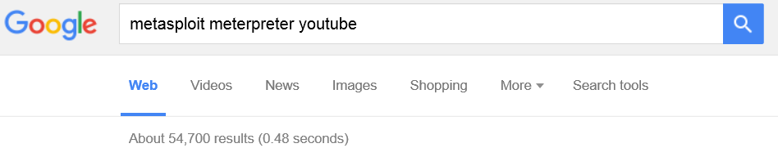

Slide 63
Additional Key Terms

Slide 64
DEMONSTRATION

Slide 65
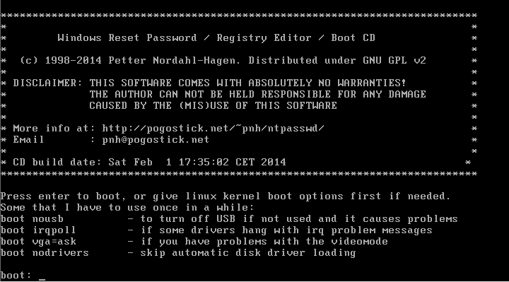
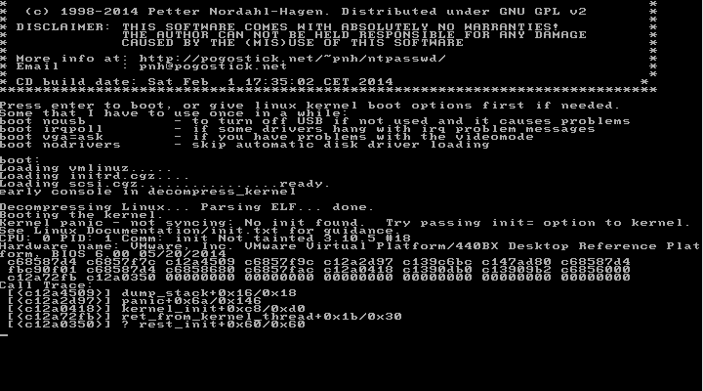
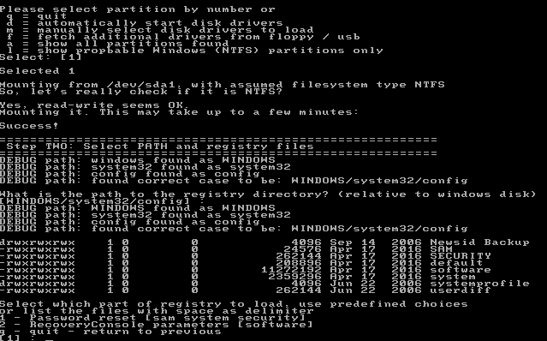
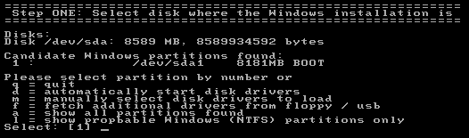
Need Access to Another VM
https://pogostick.net/~pnh/ntpasswd/

Slide 66
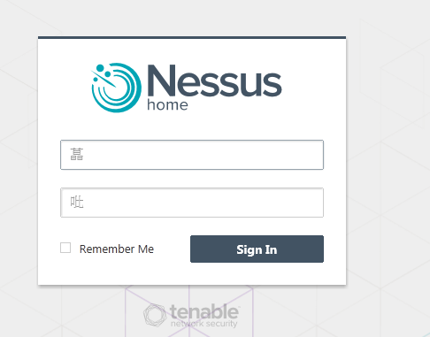
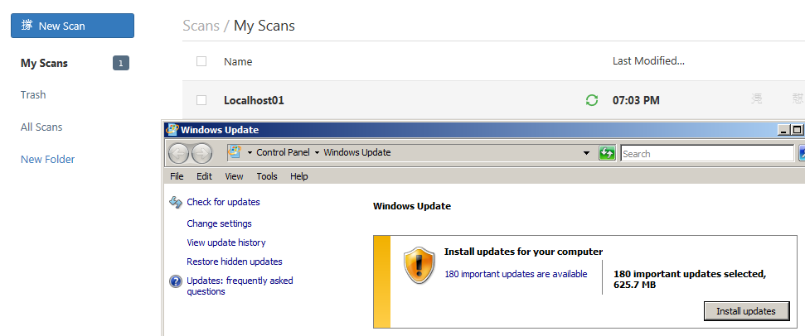

Slide 67
Final Thoughts

Slide 68
Final Thoughts

Slide 69








From Authorities to Audits
Examples
Technical, physical, and administrative requirements that must be in place to ensure compliance with the authorities
Statements of how a company will implement and enforce requirements
Implementation of the technical, physical, and administrative requirements found in the policy statements
Verification of appropriately implemented controls to comply with requirements
Authorities
Requirements
Gold Standard
Controls
Audits
PCI-DSS Example
Authority: PCI-DSS is the authority document created by the PCI-SSC.
Requirement: (10.6) Review logs for all system components at least daily.
Policy: Monitoring Policy – States logs will be reviewed at least daily.
Control: Tool XYZ provides real-time monitoring for all system components.
Audit: Auditor verifies Tool XYZ is appropriately monitoring and alerting to actionable events. Audit results and evidence are stored as part of the audit.

Slide 70
Effectively Managed IT Controls
Technology can affect every part of the business.
At its best, technology is a competitive advantage.
At its worst, technology is your competitor’s advantage.
Product
Market Relationships
IT Controls:
Detective, protective and reactive measures in place to protect the confidentiality, integrity, and availability of business information and ensure appropriate management of the IT function to meet business objectives.
Inbound Logistics
Operations
Outbound Logistics
Marketing
and Sales
Service
Firm Infrastructure
HR Management
Margin
Procurement
Technology Development
Notes:
Compliance Control: A process, effected by management and other personnel, designed to provide reasonable assurance that transactions are executed in accordance with 1) laws governing the use of budget authority and other laws and regulations that could have a direct and material effect on the financial statements or required supplementary stewardship information and 2) any other laws, regulations, and government wide policies identified in OMB audit guidance. [GAO/PCIE Financial Audit Manual]
Source: http://www.unifiedcompliance.com/it_compliance/language_compliance/definitions/c.html

Slide 71
Chris Davis
UTD Email: cmd140430@utdallas.edu
Google Voice: 214-771-8122
Course Materials
https://elearning.utdallas.edu

Slide 72
Additional Materials

Slide 73

Today's Materials
Harris, Shon (2012-11-08).
CISSP All-in-One Exam Guide, 6th Edition.
McGraw-Hill Education.

Slide 74
Metrics Overview
This information is too good to skip over. Let’s spend a few minutes capturing the highlights.

Slide 75
Metrics
Good security metrics should be:
Aligned with business value (demonstrating risks to critical assets and success in mitigating those risks)
Controllable (showing results can be improved through effort)
Based on quantitative and objective data (using real-world numbers)
Low overhead (placing a limited burden on available time and resources)
Capable of trending over time (indicating progress or lack of progress)
75

Slide 76
Metrics
Examples of Metrics That Align With Business Goals
Disruptions to shipping/sales/manufacturing/etc due to security incidents
Lost productivity due to security incidents
Percentage of spam messages reported by users (relates to the business goal of productivity)
Number of security-related help desk calls (relates to usability)
Percentage of audit findings addressed within some predefined time period (relates to compliance)
Examples of Metrics That Do Not Align With Business Goals
Number of critical vulnerabilities identified (no mapping to business assets)
Number of viruses or instances of spyware, adware or spam caught (no indication of whether the number represents a high or low percentage or resulting business disruption)
Number of packets dropped at the firewall (no meaningful comparisons)
76

Slide 77
Metrics
Examples of Metrics That Indicate Controllability
Percentage of servers that meet minimum security baselines
Changes in the number of workstations vulnerable to a given exploit (month-over-month)
Percentage of workstations protected with mandatory security tools (e.g. Antivirus, Antispyware, Personal Firewall, Patching)
Percentage of audit findings addressed
Examples of Metrics That Do Not Indicate Controllability
Number of viruses caught
Number of packets dropped at the firewall
Number of e-mail messages tagged as spam
77

Slide 78
Metrics
Examples of High-Quality (Objective and Quantitative) Data
Twenty percent of user accounts have not logged on in 90 days.
The security organization completed 75% of assigned projects on time and within budget during the first half of the fiscal year.
Thirty-three percent of critical risks were remediated within seven days.
Examples of Poor-Quality (Subjective and Qualitative) Data
The IDS identifies a lot of attempted attacks.
Most of the security organization's projects have been completed on time in the past year.
Most audit findings have been addressed.
We patch all of our servers on "Patch Tuesday".
78

Slide 79
Metrics
Examples of Reasonable Effort
Extracting tool output and aggregating that input to a centralized printed report or Web portal.
Collecting and correlating data from pre-existing survey information.
Collection and analysis that takes less than one week.
Examples of Excessive or Unreasonable Effort
Reporting requires printing and analyzing large numbers of different reports.
New surveys are conducted monthly with multiple business units.
Monthly collection and analysis takes as much as three weeks and is barely finished before the next reporting cycle begins.
79

Slide 80
Metrics
Examples of Metrics That Show Trending
Sarbanes-Oxley Act audit findings (year-over-year)
Percentage of servers that are noncompliant with the standard build (on a monthly basis)
Source of Metric information: ‘The Do’s and Don’ts of Information Security Metrics’ by Jeffrey Wheatman, Gartner
80

Slide 81
MODELS

Slide 82
FIGURE 2-2: RISK MANAGEMENT FRAMEWORK
NIST Special Publication 800-37 Revision 1
Guide for Applying the Risk Management Framework to Federal Information Systems
A Security Life Cycle Approach

Slide 83
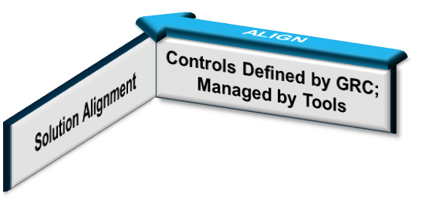
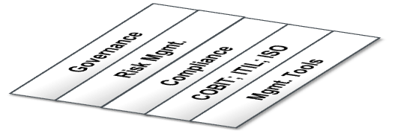
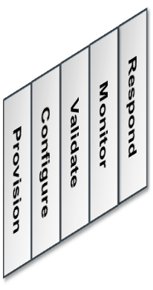
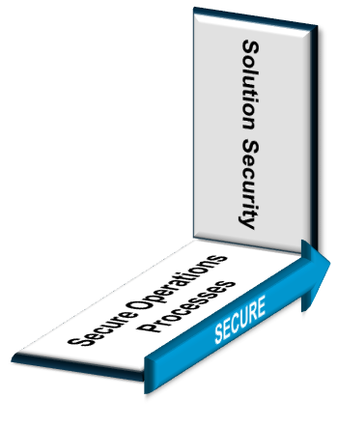


Requirements
Processes
Work Loads

